Slide 1
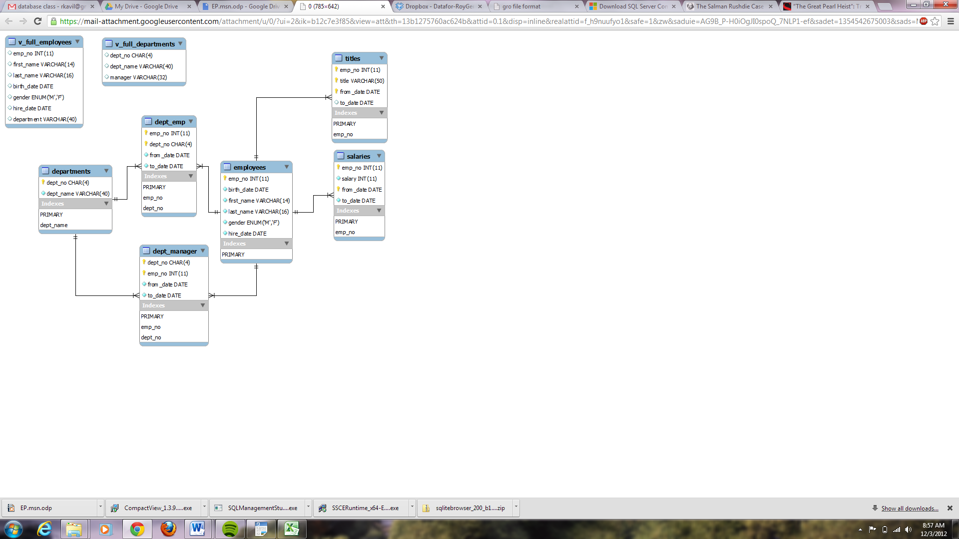
Database Schema

Slide 2
Queries I Single Table Queries
Find all information on employees
Find the first and last names of employees
Find unique titles in the employee database
Find the employee number, start date and monthly salary of each employee
Find the employee number of all employees who make between $60000 and $71000 (both inclusive)
Find all information about employees whose last name or first name is Demeyer
Find employee numbers, start and end date of all employees who are Senior Engineers, Assistant Engineers, Engineers, or Technique Leaders
Use the IN statement
Find employee numbers, start and end date of all employees whose name is not Facello, Zielinski, Haddadi, Berztiss or Demeyer

Slide 3
Queries II Pattern Matching
Find all employees who have the letters ‘lin’ in their last name
Find salaries of employees by ascending order, and descending order of start date

